Slide 1
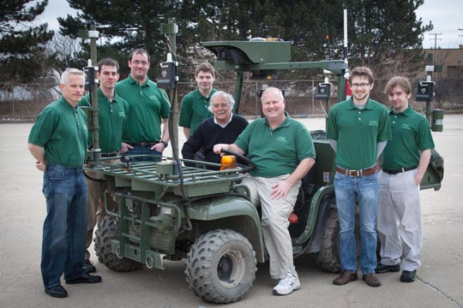
Wayne Blizman
April 24, 1939 - September 28. 2014

Slide 2
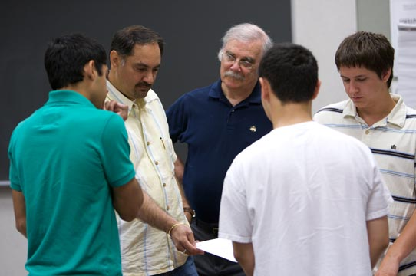
It is not always that you meet someone that has spent so many years in business make a great transition to teaching students with a passion that is unparalleled. I have seen him coordinate entrepreneurship camps for high school students, make non-business OU majors think like entrepreneurs, and help business school create an ideas to business program with passion and dedication. He has been a great friend and I shall miss him dearly. But, in a way, he wanted to join his wife and give her company. - Mohan Tanniru
Wayne was a colleague and always had a smile and a joke to tell. I will miss that smile and humor for sure. The hallways will not be the same without him. He loved his students and his work at OU. He will be greatly missed.
Amy Rutledge

Slide 3
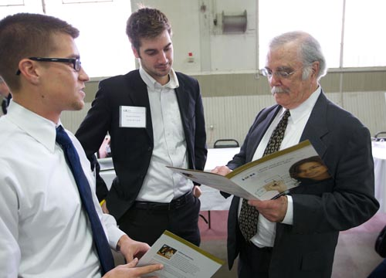
I worked with Wayne since the inception of the i2B Program. He was funny and so easy going. He sat in my office a week before last talking and getting him ready for the move back into the office beside mine. I think about his family. I am so sorry for your loss.
Judy Vamossy
Wayne was my colleague but more than that a good friend. He would stop by my office to say hi and in 5 minutes he had me laughing and reminiscing about our corporate days. He loved his students and Oakland. He will be greatly missed by all.
Judy Martin

Slide 4
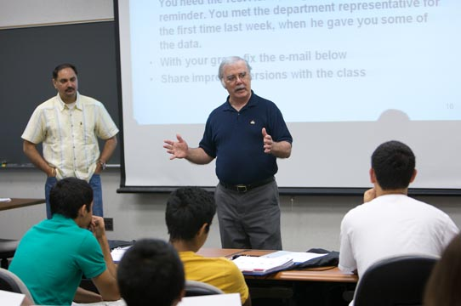
Wayne was my friend and colleague at the Macomb OU Incubator. He will be remembered as the special man and friend he was, always. Every day I sat with Wayne, whether formally or informally, he always found a way to make me and everyone around him smile. He was a private, intelligent, giving and wonderful man. Clearly he could wait no longer to be with his wife. My condolences and prayers are with you. - Mike Brennan
Wayne was my mentor. He took me under his wing and patiently answered all of my many questions with wisdom. He was always there for me, and always loved to joke on/with me. I cant even begin to express how significant his influence on my life has been. One of the best men I've ever had the pleasure of being in the company of. Much love and Godspeed sir. You will be missed more then you'll ever know. - Brennon Edwards

Slide 5
Wayne was my Friend and business advisor. I met him through the OU Incubator and he has been helping me for many years. I spoke with Wayne the day before he passed away. He was looking forward to spending time with his son and grandchildren up North. We made plans to have lunch together when he returned. I am very grateful for having known Wayne and I will miss him greatly.
Paul Fleck

